Slide 1

ONLINE CLASS
GRAPH THEORY
BICTE $6^{TH}$ SEMESTER
2078/02/25
PRESENTED BY KALYAN DAHAL

Slide 2
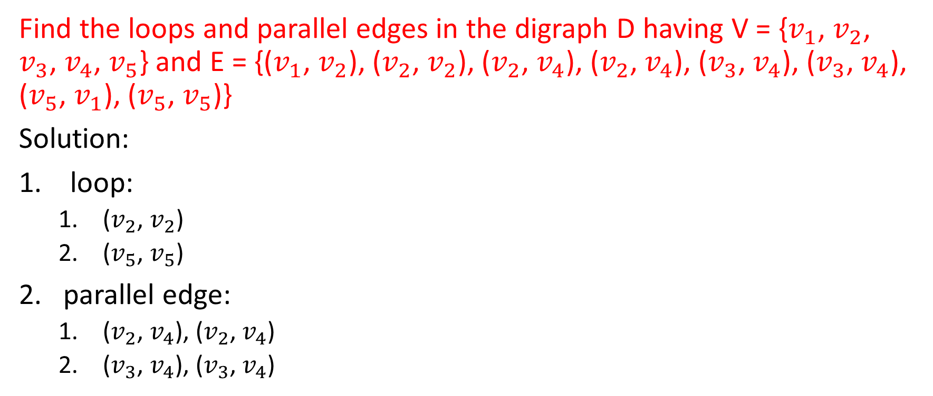
Exercise
Find the loops and parallel edges in the digraph D having V = {$v_{1}$, $v_{2}$, $v_{3}$, $v_{4}$, $v_{5}$} and E = {($v_{1}$, $v_{2}$), ($v_{2}$, $v_{2}$), ($v_{2}$, $v_{4}$), ($v_{2}$, $v_{4}$), ($v_{3}$, $v_{4}$), ($v_{3}$, $v_{4}$), ($v_{5}$, $v_{1}$), ($v_{5}$, $v_{5}$)}
Solution:
loop:
($v_{2}$, $v_{2}$)
($v_{5}$, $v_{5}$)
parallel edge:
($v_{2}$, $v_{4}$), ($v_{2}$, $v_{4}$)
($v_{3}$, $v_{4}$), ($v_{3}$, $v_{4}$)

Slide 3
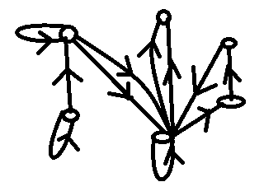








Draw the digraphs having V = {$v_{1}$, $v_{2}$, $v_{3}$, $v_{4}$, $v_{5}$} and
(a) E = {($v_{1}$, $v_{1}$), ($v_{2}$, $v_{2}$), ($v_{3}$, $v_{3}$), ($v_{1}$, $v_{3}$), ($v_{1}$, $v_{3}$), ($v_{2}$, $v_{1}$), ($v_{3}$, $v_{6}$), ($v_{3}$, $v_{4}$), (($v_{4}$, $v_{5}$), ($v_{5}$, $v_{3}$), ($v_{3}$, $v_{6}$)}
$$v_{1}$$
$$v_{6}$$
$$v_{5}$$
$$v_{2}$$
$$v_{4}$$
$$v_{3}$$

Slide 4
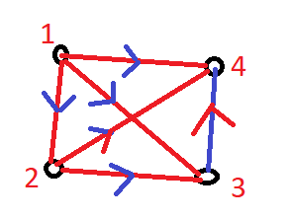
Draw a digraph D based on the relation R defined as “x is less than y” on V = {1, 2, 3, 4} where R = {(1, 2), (1, 3), (1, 4), (2, 3), (2, 4), (3, 4)}

Slide 5
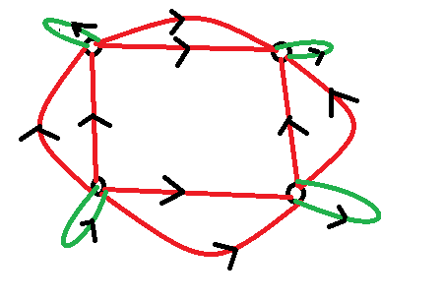

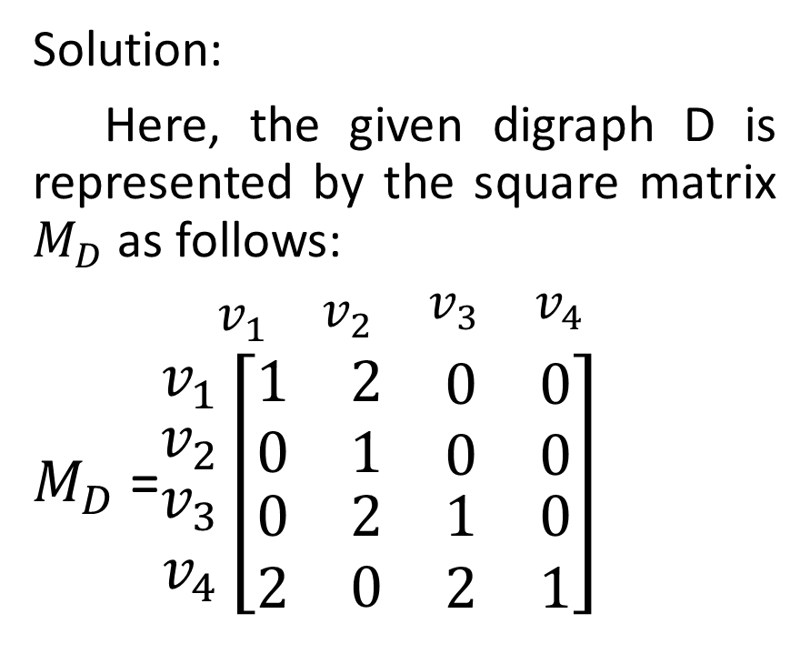



Find the matrix representation of the given digraphs.
Solution:
Here, the given digraph D is represented by the square matrix $M_{D}$ as follows:
$\begin{matrix}v_{1} & \begin{matrix}v_{2} & \begin{matrix}v_{3} & v_{4}\end{matrix}\end{matrix}\end{matrix}$
$M_{D}$ =$\begin{matrix}v_{1} \\ \begin{matrix}v_{2} \\ \begin{matrix}v_{3} \\ v_{4}\end{matrix}\end{matrix}\end{matrix}\left[\begin{matrix}1 & 2 & \begin{matrix}0 & 0\end{matrix} \\ 0 & 1 & \begin{matrix}0 & 0\end{matrix} \\ \begin{matrix}0 \\ 2\end{matrix} & \begin{matrix}2 \\ 0\end{matrix} & \begin{matrix}\begin{matrix}1 & 0\end{matrix} \\ \begin{matrix}2 & 1\end{matrix}\end{matrix}\end{matrix}\right]$
$$v_{2}$$
$$v_{1}$$
$$v_{4}$$
$$v_{3}$$

Slide 6
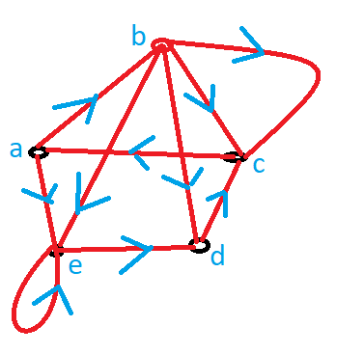
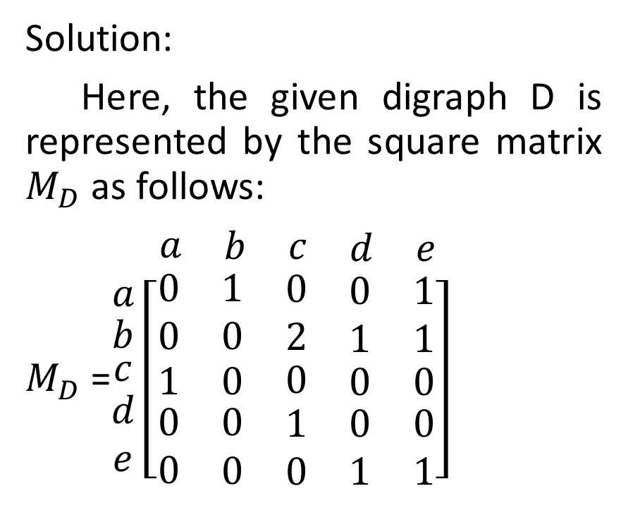
Find the matrix representation of the given digraphs.
Solution:
Here, the given digraph D is represented by the square matrix $M_{D}$ as follows:
$\begin{matrix}a & \begin{matrix}b & \begin{matrix}c & \begin{matrix}d & e\end{matrix}\end{matrix}\end{matrix}\end{matrix}$
$M_{D}$ =$\begin{matrix}a \\ \begin{matrix}b \\ \begin{matrix}c \\ \begin{matrix}d \\ e\end{matrix}\end{matrix}\end{matrix}\end{matrix}\left[\begin{matrix}0 & 1 & \begin{matrix}0 & \begin{matrix}0 & 1\end{matrix}\end{matrix} \\ 0 & 0 & \begin{matrix}2 & \begin{matrix}1 & 1\end{matrix}\end{matrix} \\ \begin{matrix}1 \\ \begin{matrix}0 \\ 0\end{matrix}\end{matrix} & \begin{matrix}0 \\ \begin{matrix}0 \\ 0\end{matrix}\end{matrix} & \begin{matrix}\begin{matrix}0 & \begin{matrix}0 & 0\end{matrix}\end{matrix} \\ \begin{matrix}\begin{matrix}1 \\ 0\end{matrix} & \begin{matrix}\begin{matrix}0 & 0\end{matrix} \\ \begin{matrix}1 & 1\end{matrix}\end{matrix}\end{matrix}\end{matrix}\end{matrix}\right]$

Slide 7
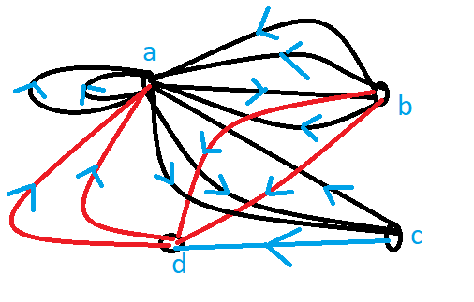
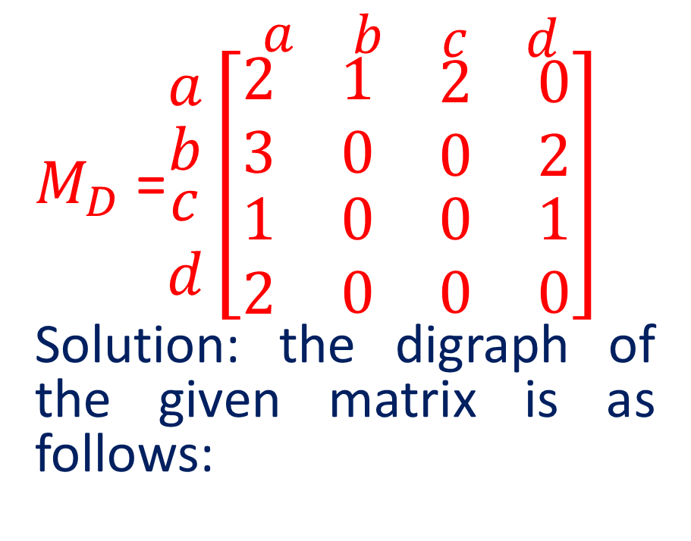
Draw the digraph of the given matrix.
$\begin{matrix}a & \begin{matrix}b & \begin{matrix}c & d\end{matrix}\end{matrix}\end{matrix}$
$M_{D}$ =$\begin{matrix}a \\ \begin{matrix}b \\ \begin{matrix}c \\ d\end{matrix}\end{matrix}\end{matrix}\left[\begin{matrix}2 & 1 & \begin{matrix}2 & 0\end{matrix} \\ 3 & 0 & \begin{matrix}0 & 2\end{matrix} \\ \begin{matrix}1 \\ 2\end{matrix} & \begin{matrix}0 \\ 0\end{matrix} & \begin{matrix}\begin{matrix}0 & 1\end{matrix} \\ \begin{matrix}0 & 0\end{matrix}\end{matrix}\end{matrix}\right]$
Solution: the digraph of the given matrix is as follows:

Slide 8
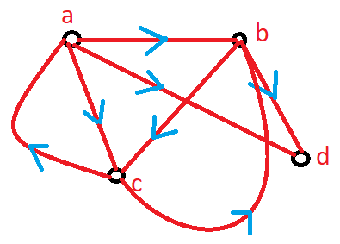


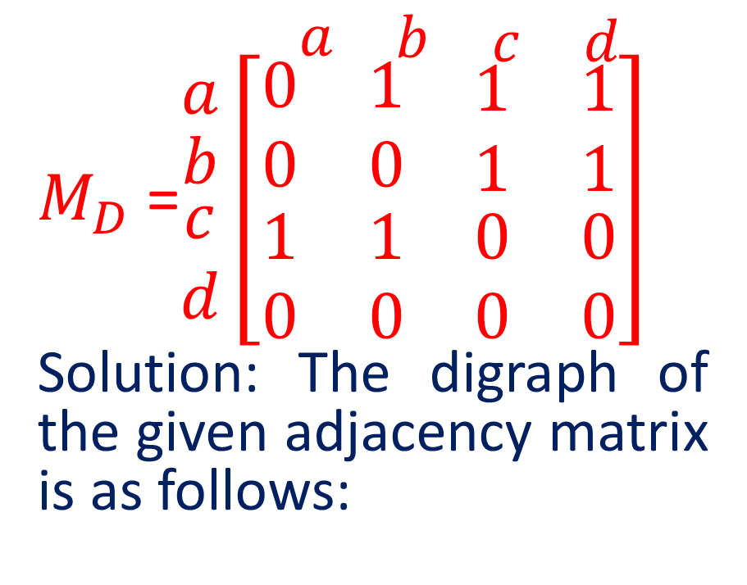





Draw the digraph of the given adjacency matrix and then find its incidence matrix.
$$e_{1}$$
$\begin{matrix}a & \begin{matrix}b & \begin{matrix}c & d\end{matrix}\end{matrix}\end{matrix}$
$M_{D}$ =$\begin{matrix}a \\ \begin{matrix}b \\ \begin{matrix}c \\ d\end{matrix}\end{matrix}\end{matrix}\left[\begin{matrix}0 & 1 & \begin{matrix}1 & 1\end{matrix} \\ 0 & 0 & \begin{matrix}1 & 1\end{matrix} \\ \begin{matrix}1 \\ 0\end{matrix} & \begin{matrix}1 \\ 0\end{matrix} & \begin{matrix}\begin{matrix}0 & 0\end{matrix} \\ \begin{matrix}0 & 0\end{matrix}\end{matrix}\end{matrix}\right]$
Solution: The digraph of the given adjacency matrix is as follows:
$$e_{2}$$
$$e_{5}$$
$$e_{3}$$
$$e_{6}$$
$$e_{4}$$
$$e_{7}$$

Slide 9
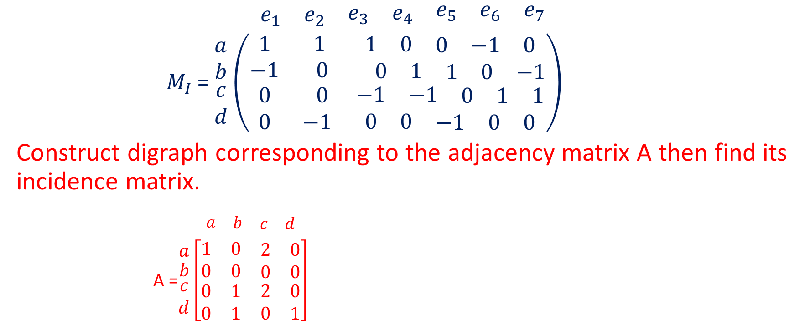
Continued…….
$$\begin{matrix}e_{1} & e_{2} & \begin{matrix}e_{3} & e_{4} & \begin{matrix}e_{5} & e_{6} & e_{7}\end{matrix}\end{matrix}\end{matrix}$$
$M_{I}$ = $\begin{matrix}a \\ b \\ \begin{matrix}c \\ d\end{matrix}\end{matrix}$ $\left(\begin{matrix}1 & 1 & \begin{matrix}1 & 0 & \begin{matrix}0 & −1 & 0\end{matrix}\end{matrix} \\ −1 & 0 & \begin{matrix} 0 & 1 & \begin{matrix}1 & 0 & −1\end{matrix}\end{matrix} \\ \begin{matrix}0 \\ 0\end{matrix} & \begin{matrix} 0 \\ −1\end{matrix} & \begin{matrix}\begin{matrix}−1 & −1 & \begin{matrix}0 & 1 & 1\end{matrix}\end{matrix} \\ \begin{matrix}0 & 0 & \begin{matrix}−1 & 0 & 0\end{matrix}\end{matrix}\end{matrix}\end{matrix}\right)$
Construct digraph corresponding to the adjacency matrix A then find its incidence matrix.
$\begin{matrix}a & \begin{matrix}b & \begin{matrix}c & d\end{matrix}\end{matrix}\end{matrix}$
A =$\begin{matrix}a \\ \begin{matrix}b \\ \begin{matrix}c \\ d\end{matrix}\end{matrix}\end{matrix}\left[\begin{matrix}1 & 0 & \begin{matrix}2 & 0\end{matrix} \\ 0 & 0 & \begin{matrix}0 & 0\end{matrix} \\ \begin{matrix}0 \\ 0\end{matrix} & \begin{matrix}1 \\ 1\end{matrix} & \begin{matrix}\begin{matrix}2 & 0\end{matrix} \\ \begin{matrix}0 & 1\end{matrix}\end{matrix}\end{matrix}\right]$

Slide 10
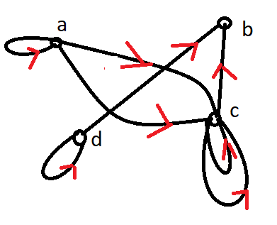








Continued…….
Solution: The digraph of the given adjacency matrix is as follows:
$$e_{7}$$
$$e_{2}$$
$$e_{4}$$
$$e_{1}$$
$$e_{3}$$
$$e_{6}$$
$$e_{5}$$
$$e_{8}$$

Slide 11
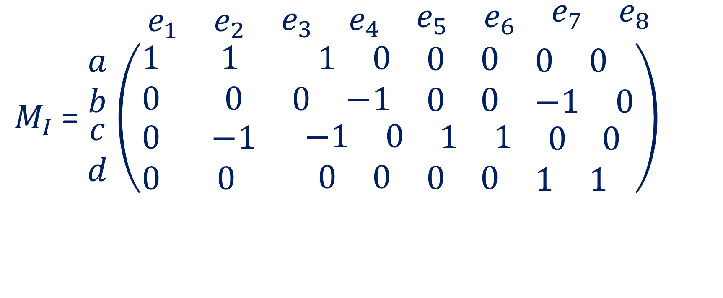
Continued…….
$\begin{matrix}e_{1} & e_{2} & \begin{matrix}e_{3} & e_{4} & \begin{matrix}e_{5} & e_{6} & \begin{matrix}e_{7} & e_{8}\end{matrix}\end{matrix}\end{matrix}\end{matrix}$
$M_{I}$ = $\begin{matrix}a \\ b \\ \begin{matrix}c \\ d\end{matrix}\end{matrix}$ $\left(\begin{matrix}1 & 1 & \begin{matrix}1 & 0 & \begin{matrix}0 & 0 & \begin{matrix}0 & 0\end{matrix}\end{matrix}\end{matrix} \\ 0 & 0 & \begin{matrix}0 & −1 & \begin{matrix}0 & 0 & \begin{matrix}−1 & 0\end{matrix}\end{matrix}\end{matrix} \\ \begin{matrix}0 \\ 0\end{matrix} & \begin{matrix} −1 \\ 0\end{matrix} & \begin{matrix}\begin{matrix}−1 & 0 & \begin{matrix}1 & 1 & \begin{matrix}0 & 0\end{matrix}\end{matrix}\end{matrix} \\ \begin{matrix}0 & 0 & \begin{matrix}0 & 0 & \begin{matrix}1 & 1\end{matrix}\end{matrix}\end{matrix}\end{matrix}\end{matrix}\right)$

Slide 12
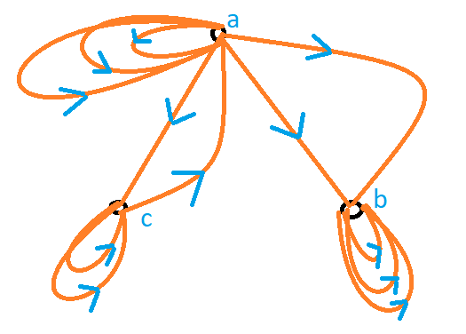
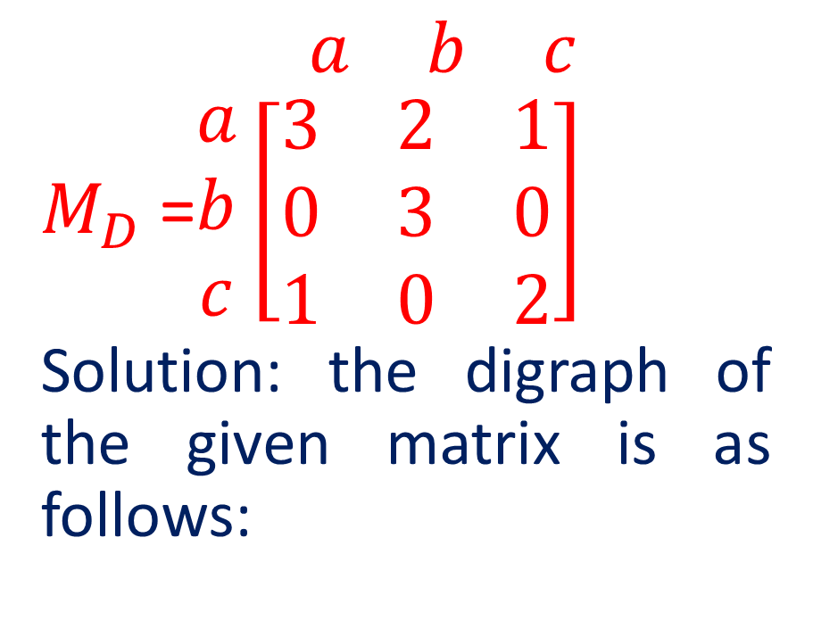
Draw the digraph of the given matrix.
$\begin{matrix}a & b & c\end{matrix}$
$M_{D}$ =$\begin{matrix}a \\ b \\ c\end{matrix}\left[\begin{matrix}3 & 2 & 1 \\ 0 & 3 & 0 \\ 1 & 0 & 2\end{matrix}\right]$
Solution: the digraph of the given matrix is as follows:

Slide 13


